Slide 1
Fiery proServer and Fiery XF 6.4 What’s new
February 2017

Slide 2
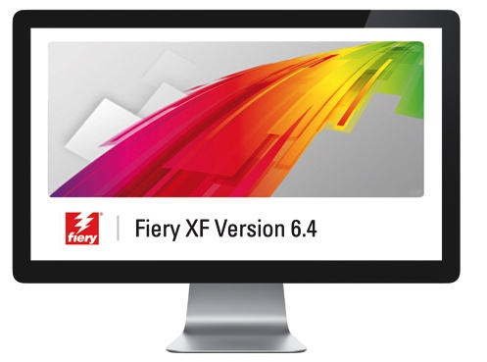
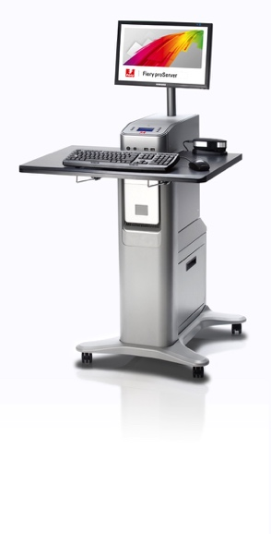
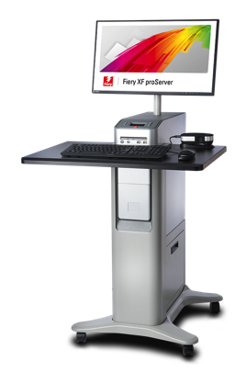
Contents
Launch information
What’s new
Resources
Availability

Slide 3
Launch information
Launch: February 6 2017
Applicable to:
Fiery® XF
All configurations
Fiery proServer
All configurations (with the exception of Fiery proServer for Cretaprint®)

Slide 4
Launch information
Important to notes:
Fiery proServer and Fiery XF 6.4 licenses are automatically activated for all customers with active ESP or SMSA agreements
The Fiery Layout Option becomes end-of-life with the launch of version 6.4

Slide 5
What’s new

Slide 6
Supported printers

Slide 7
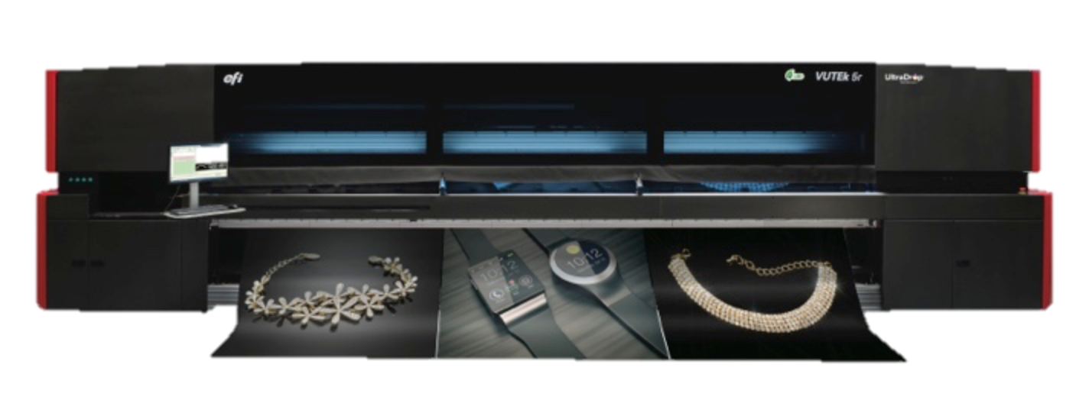
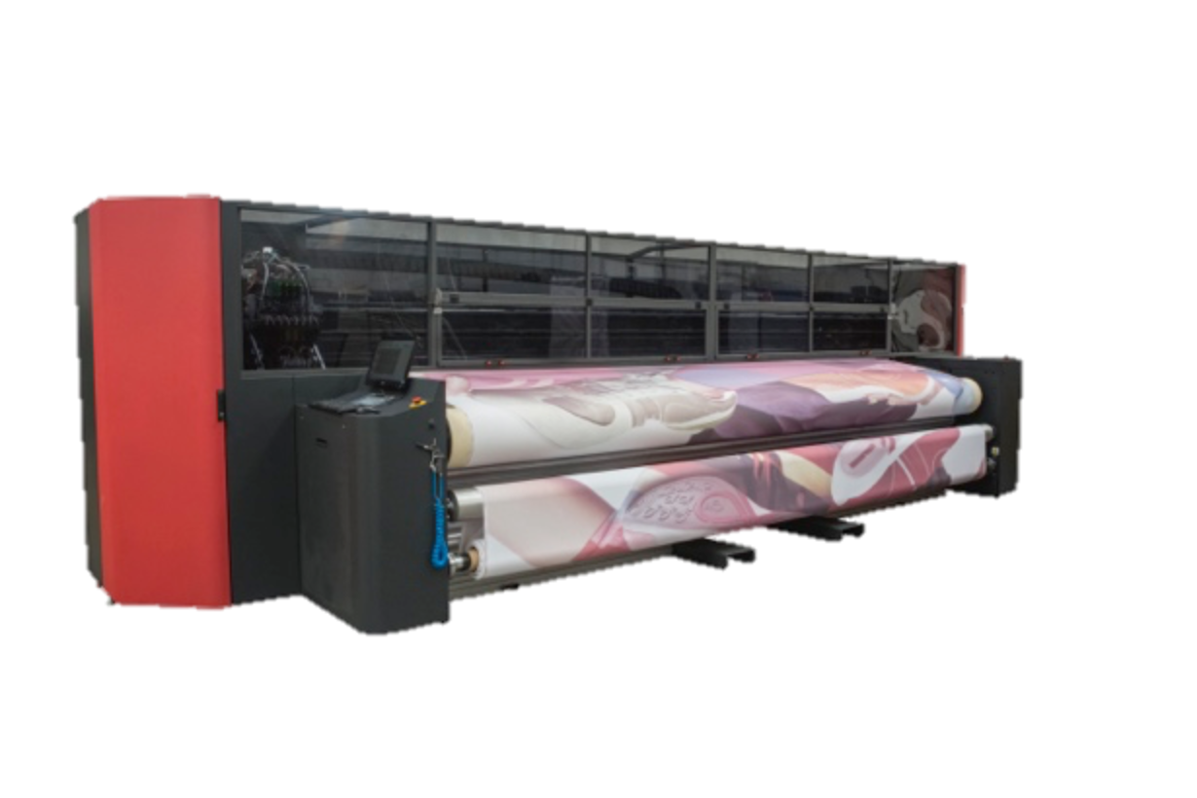
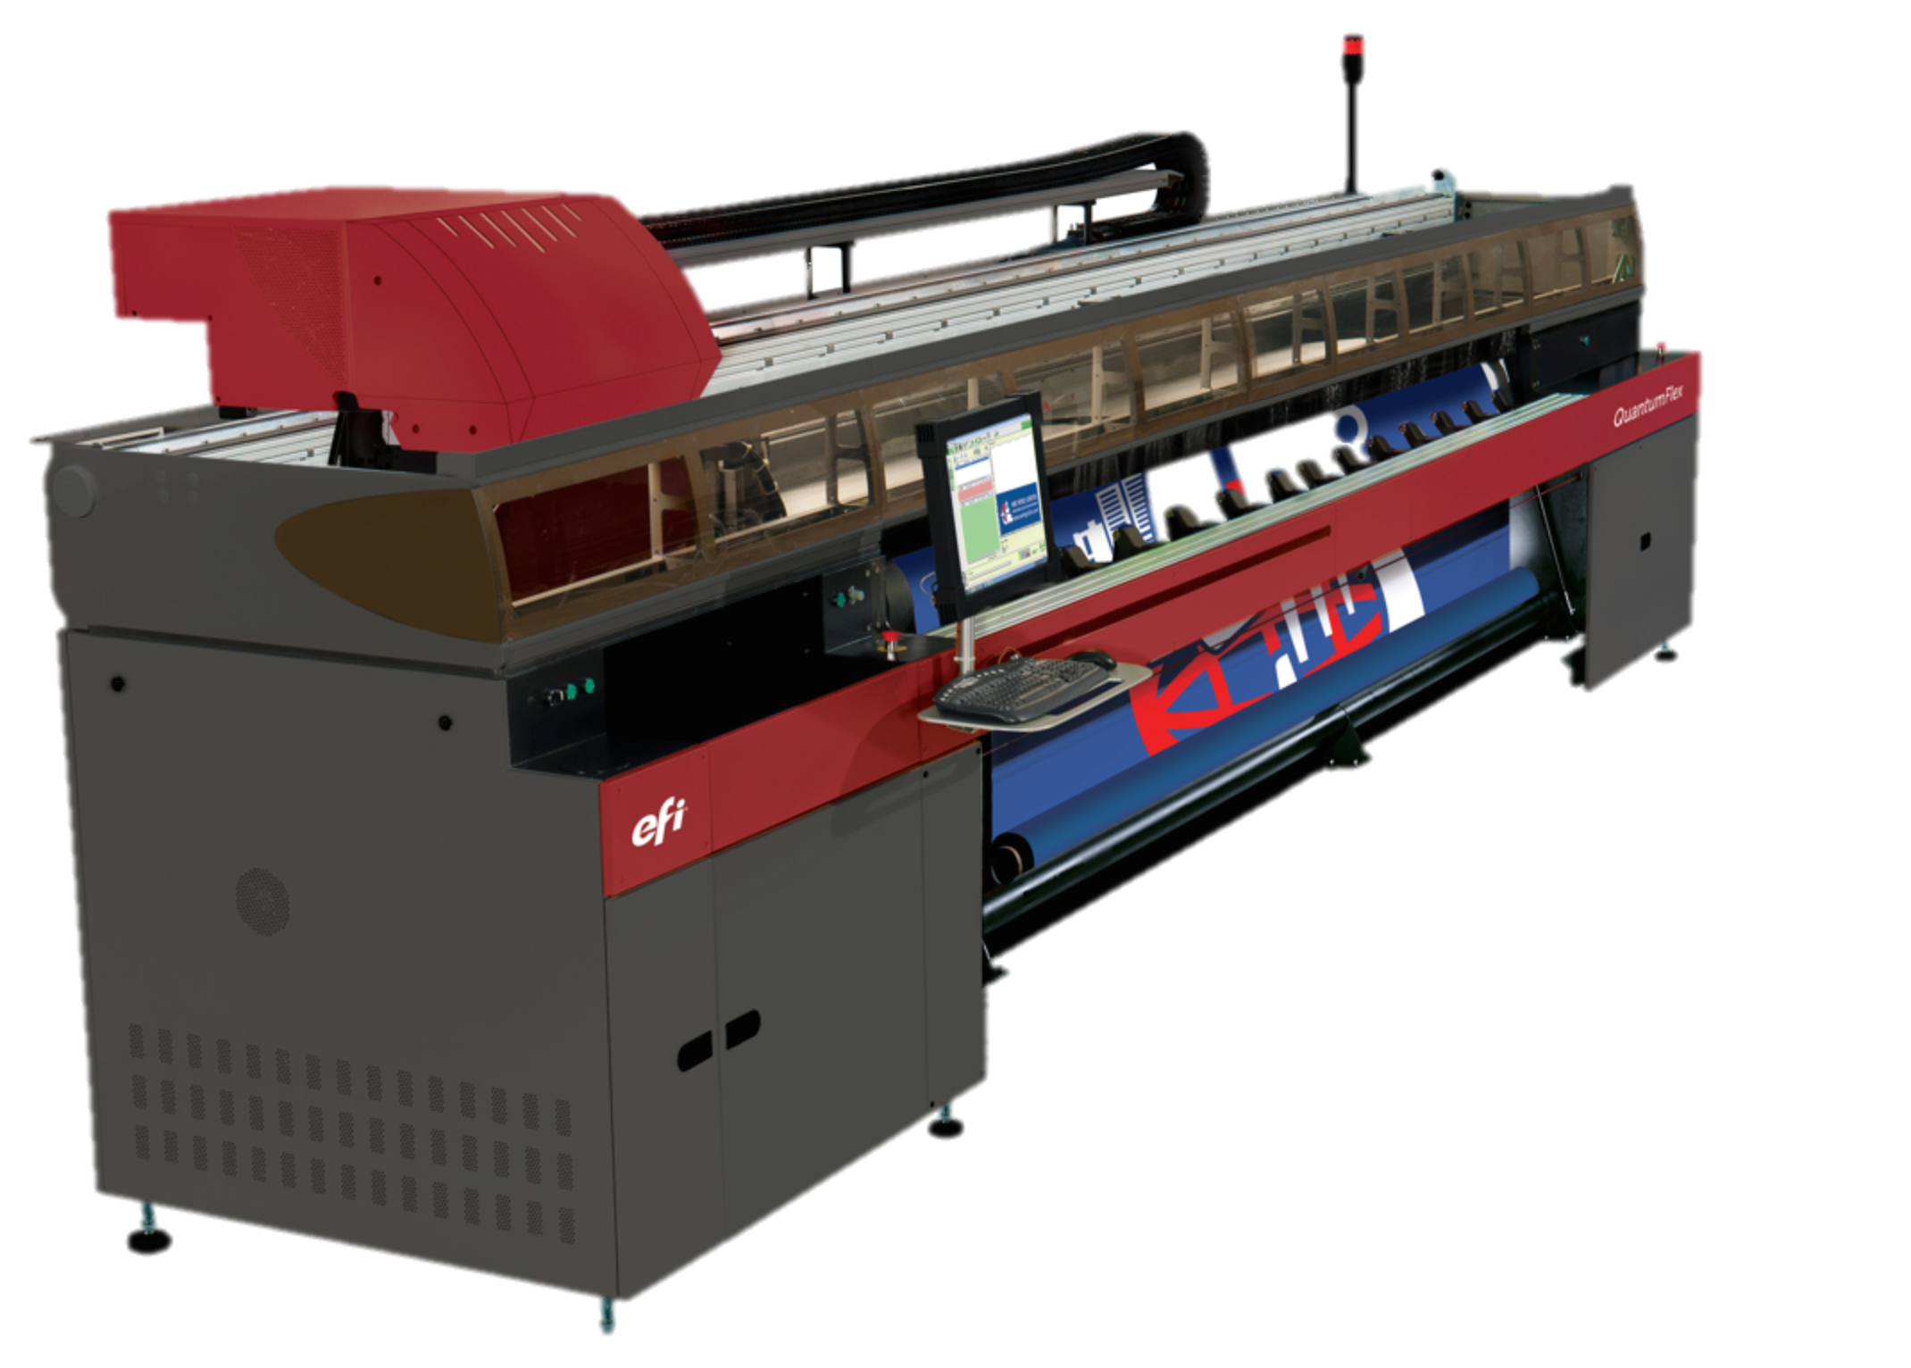
New EFI printer drivers
EFI VUTEk®
VUTEk 3r
VUTEk 5r
VUTEk FabriVU 520
EFI Matan
QuantumFlex
23 new printers join the 700+ printers already supported in Fiery proServer and Fiery XF

Slide 8
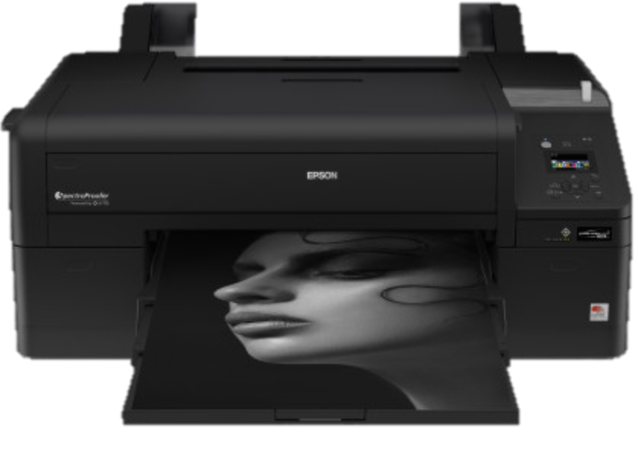
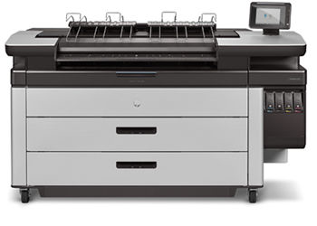
New printer drivers
EPSON®
SureColor SC-P50x0
HP
PageWide XL 4000
PageWide XL 4500
PageWide XL 5000
PageWide XL 8000

Slide 9
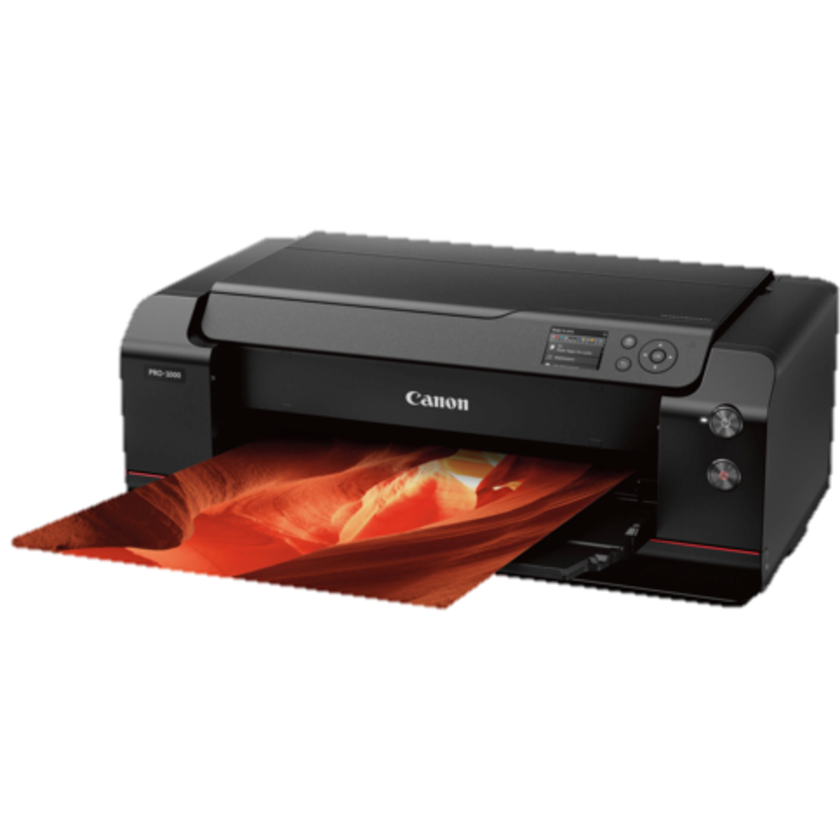
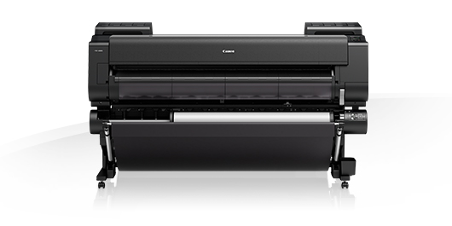
New printer drivers
Canon
imagePROGRAF PRO-1000
imagePROGRAF PRO-2000
imagePROGRAF PRO-4000
imagePROGRAF PRO-4000S
imagePROGRAF PRO-500
imagePROGRAF PRO-520
imagePROGRAF PRO-540
imagePROGRAF PRO-540S
imagePROGRAF PRO-560s
imagePROGRAF PRO-6000s

Slide 10
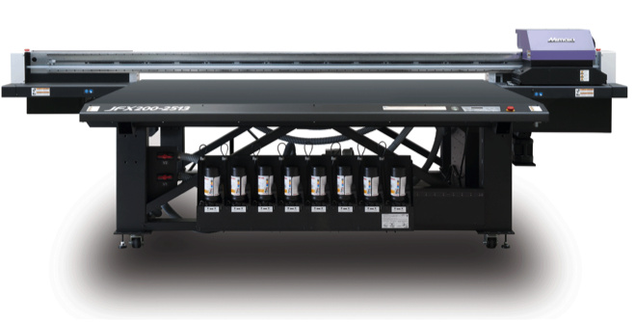
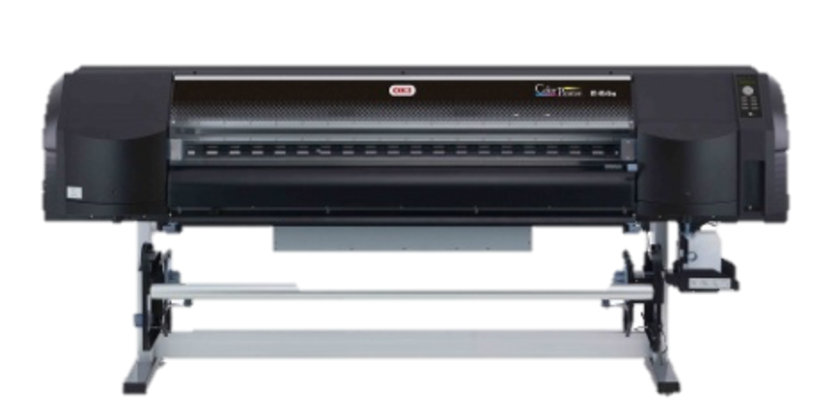
New printer drivers
Mimaki
JFX200-2513 (+White +Clear +Primer)
JFX500-2131 (+White +Clear/Primer)
TS500P-3200
Seiko/OKI
ColorPainter E-54S & E-64S
ColorPainter V-64S

Slide 11
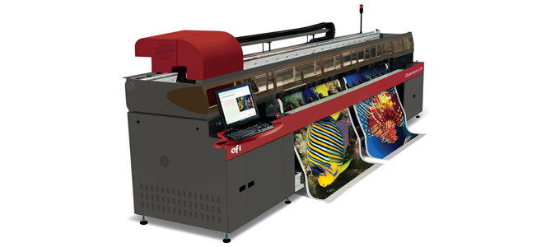
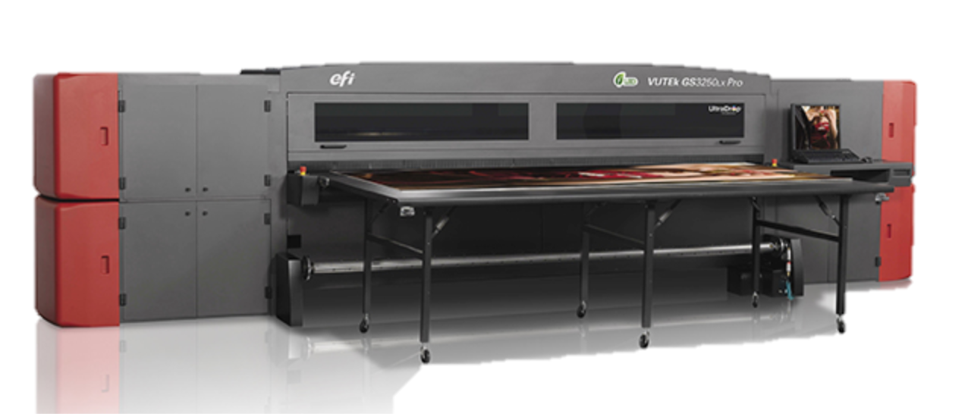
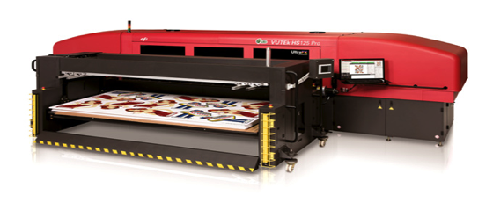
Updated EFI printer drivers
EFI Matan
Quantum LXr
Quantum
EFI VUTEk
GS2000LX Pro UD
GS3250LX Pro UD
HS100 Pro
HS125 Pro
LX3 Pro
Over 20 updated or enhanced printer drivers

Slide 12
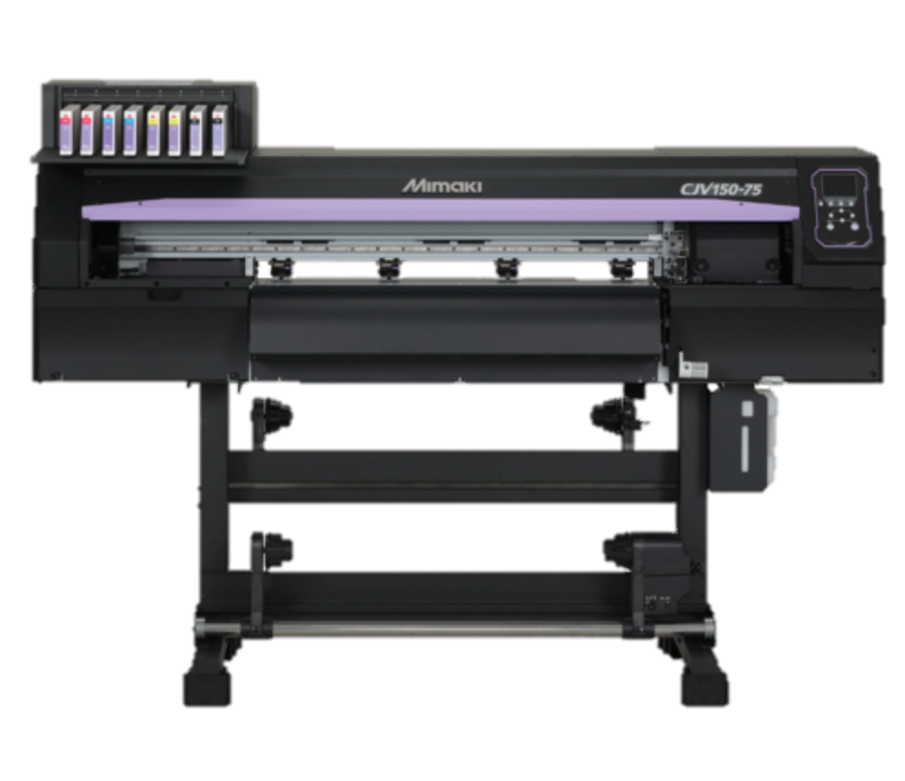
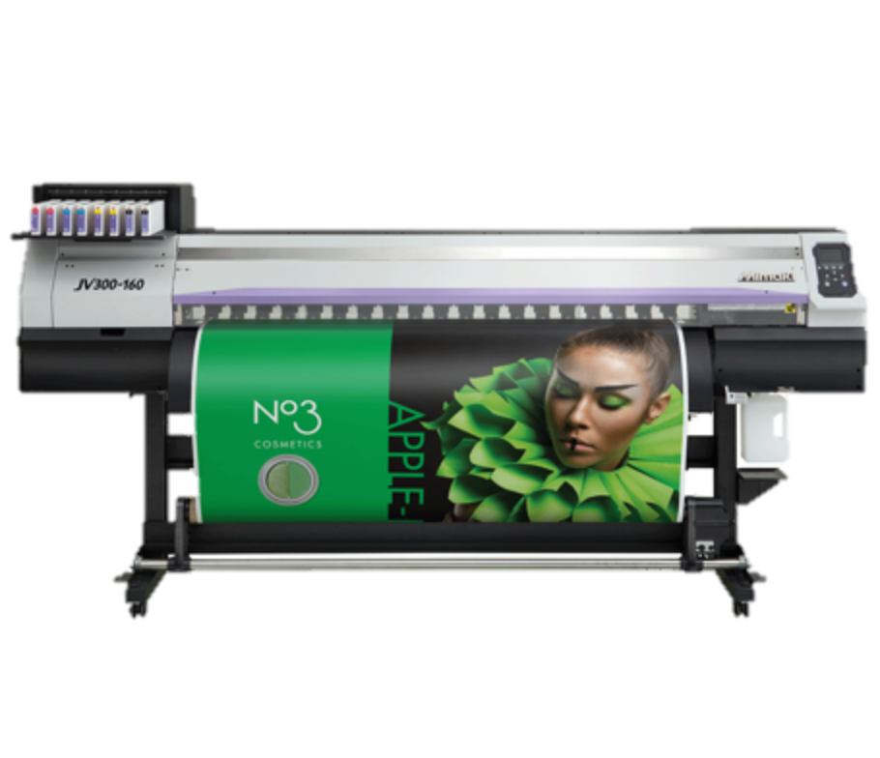
Updated printer drivers
Mimaki
CJV150-75/107/130/160
CJV300-130/160
JV300-130/160
CJV150-75/107/130/160
CJV300-130/160

Slide 13
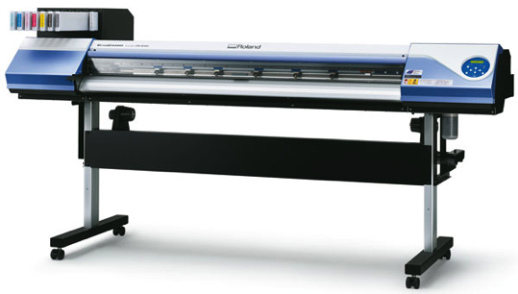
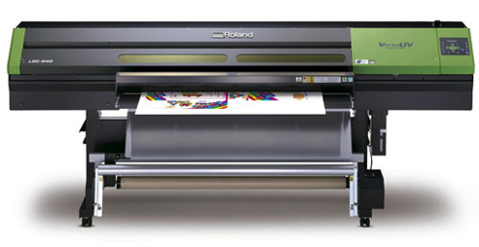
Updated printer drivers
Roland DG
VersaCAMM VS-640i/540i/300i
VersaCAMM SP-540i
VersaEXPRESS RF-640/640A
SolJet Pro 4 XF-640
LEC-300/300A
LEC-330/540
LEJ-640

Slide 14
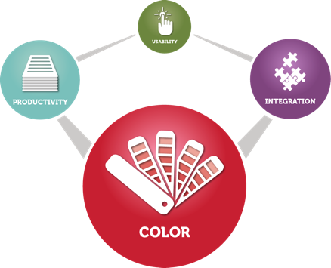
Color

Slide 15
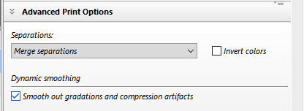
Enhanced Dynamic Smoothing
Reintroduction of the Dynamic Smoothing feature on Microsoft® Windows® platforms
For extremely smooth spot and process color gradations

Slide 16
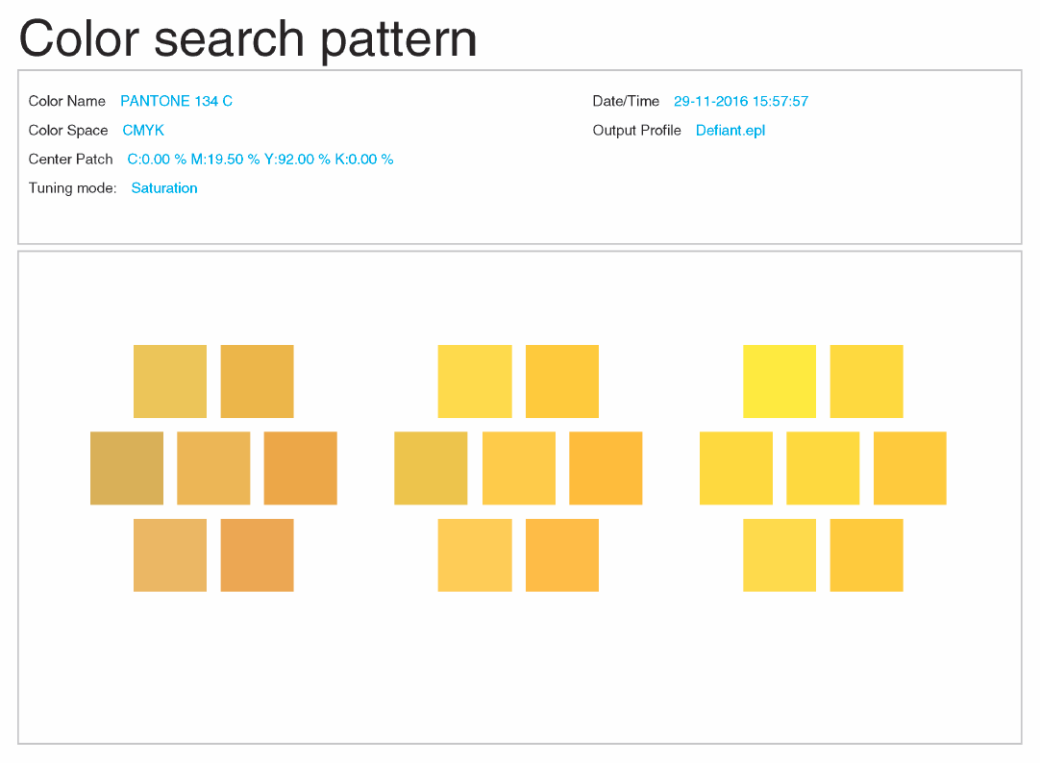
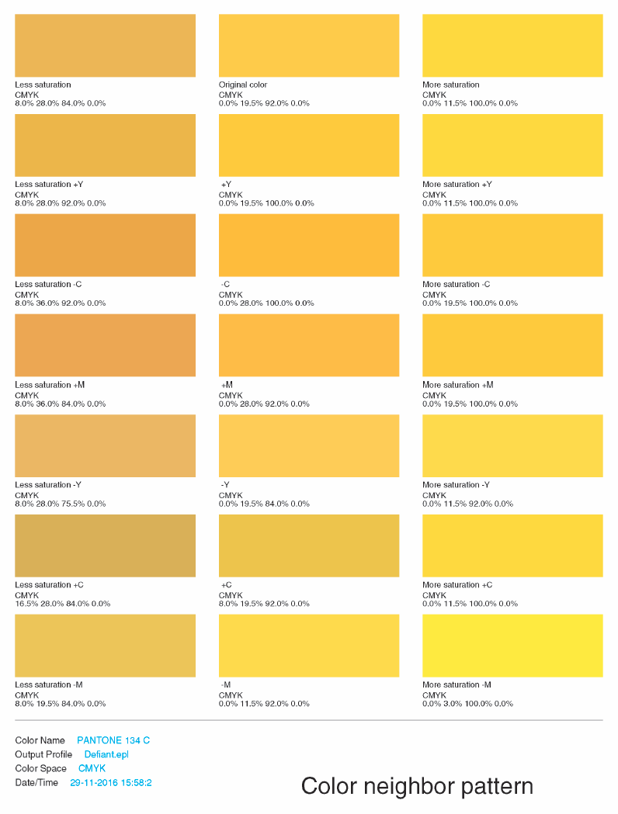
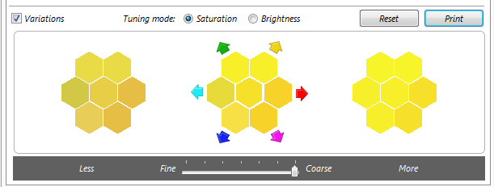
Spot Color Variations printing
Select the closest visual match for a desired color
Tune Hue, Saturation and Brightness
Adjust with fine to coarse control
Choose between two matching methods depending on preference
Perfect visual brand color matching beyond the mathematical approach

Slide 17
Improved swatch book printing
Offering additional patch sizes and larger font sizes
40x25 mm @ 9pt / 7pt font size
50x50mm @ 10pt / 8pt font size
For greater usability and visual clarity

Slide 18
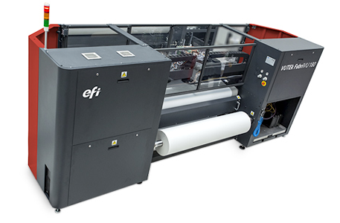
Linearization enhancements
For EFI Reggiani and EFI VUTEk FabriVU printers with
Larger linearization charts
Improved pre-linearization defaults
Improved data smoothing
For even better results when using backlit substrates

Slide 19
Improved white ink usage
Now for all EFI printers using white ink
Tonal image
Tonal image inverse
Increased printable gamut on non-white substrates plus ink savings

Slide 20
Productivity

Slide 21
FAST RIP enhancement
Run 2 FAST RIP instances
For simultaneous RIPping of files, or simultaneous RIPping and spooling
More productive and flexible job handling for Fiery proServer users

Slide 22
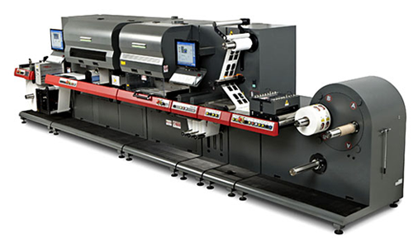
Colored cut marks for EFI Jetrion
Support for colored cut marks for the EFI Jetrion® 4900
Optimal tick mark detection whatever the substrate or cutting device used

Slide 23
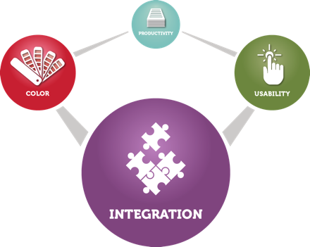
Integration

Slide 24
Updated IP printing
EFI VUTEk printer users can now change print parameters for “Submitted” or “Waiting” jobs
Greater production flexibility for all EFI VUTEk printer users

Slide 25
System improvements

Slide 26
Adobe Print Engine update
Support for APPE 4.3 on Windows platforms for:
16-Bit PDF rendering for smoother results
Expanded spot color handling of up to 127 colors

Slide 27
Operating system support
Version 6.4 is approved for use on Microsoft® Window® Server 2016

Slide 28
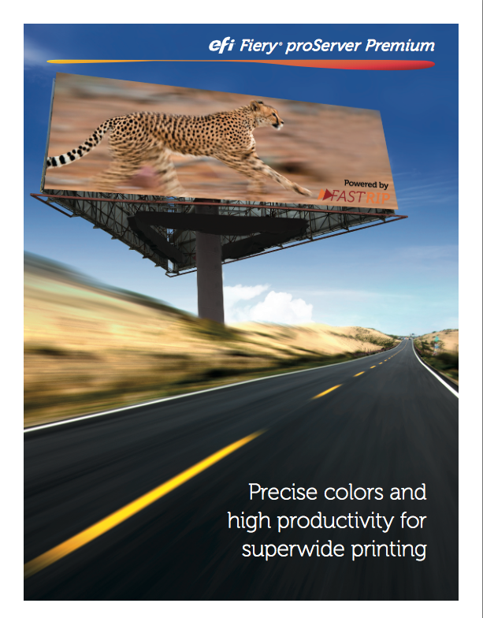
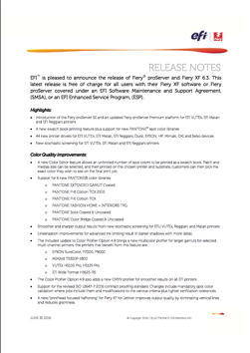
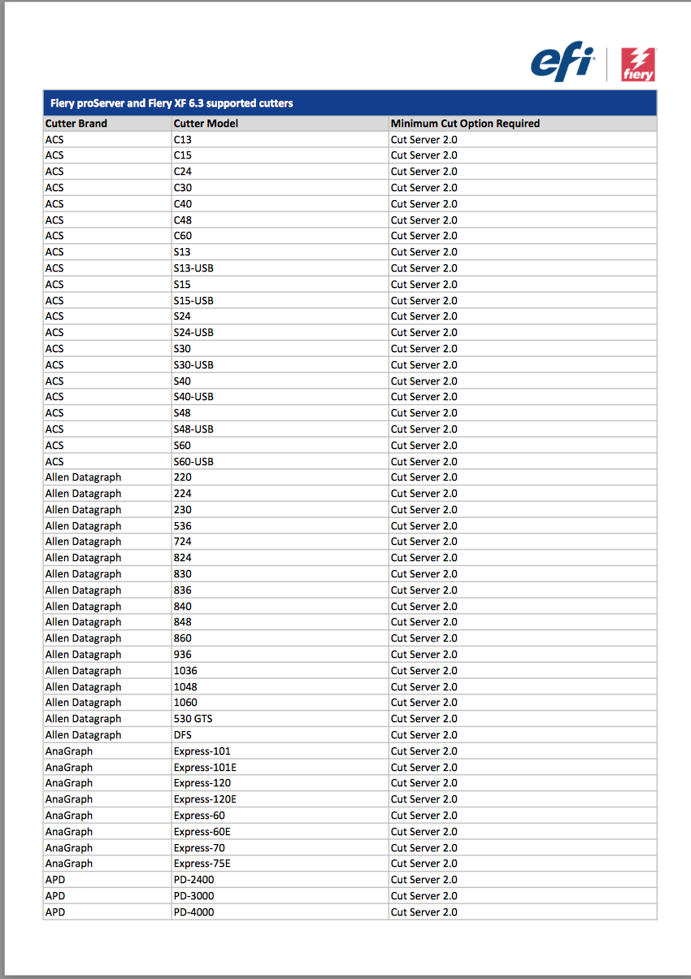
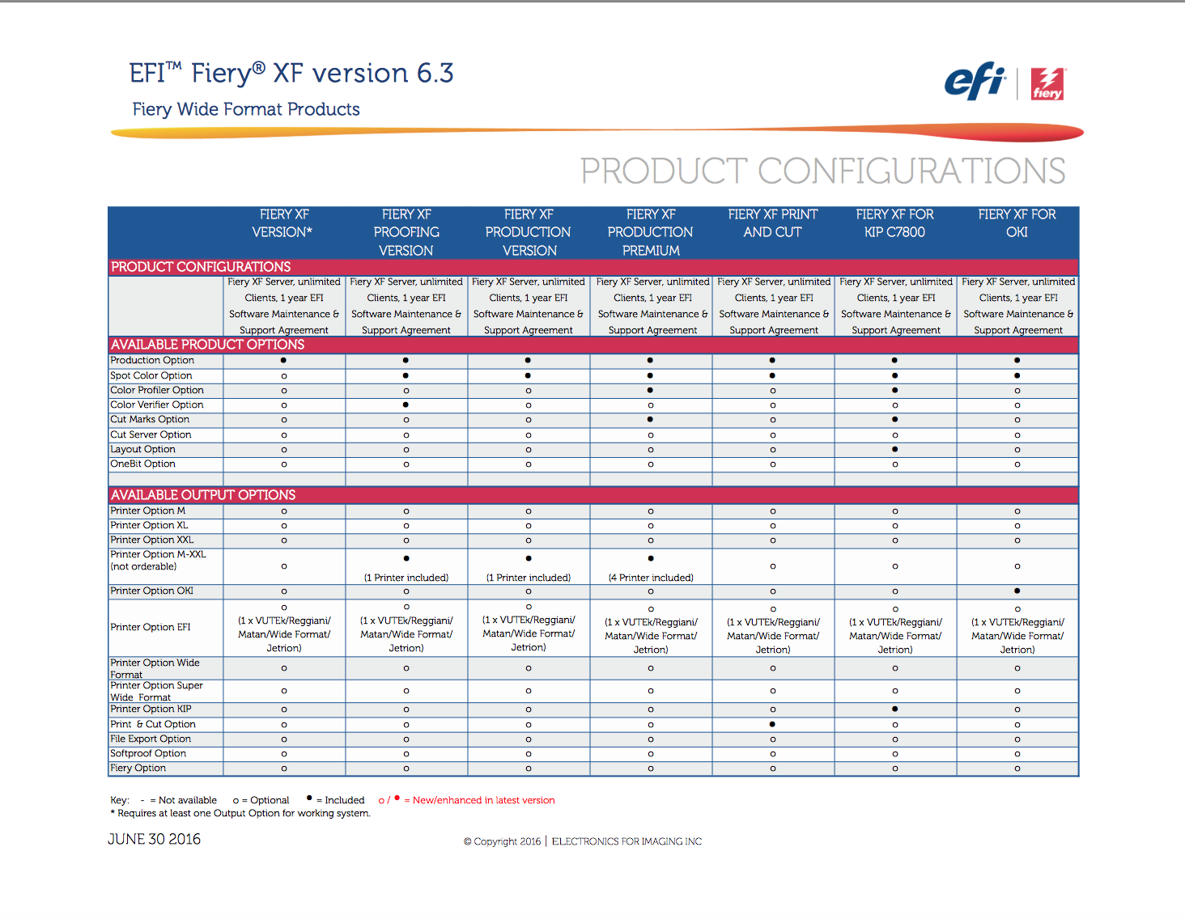
6.4 marketing materials
Updated marketing materials can be found on efi.com and the Fiery Partner Portal
Release Notes – US English
Feature Chart - US English
Configuration Comparison - US English
System Requirements & Recommendations - US English
Supported Printer List - US English
Supported Cutter List - US English

Slide 29
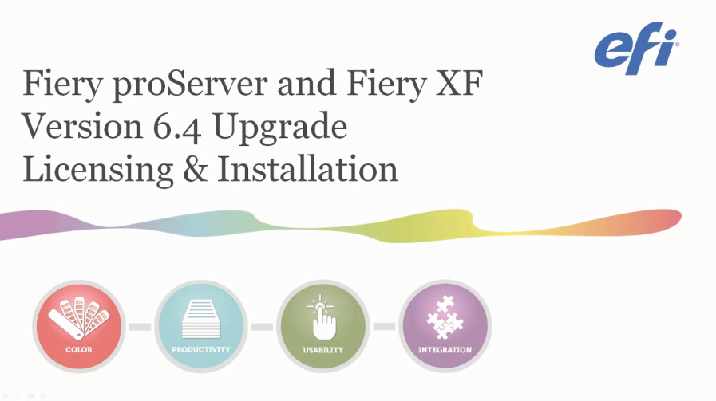
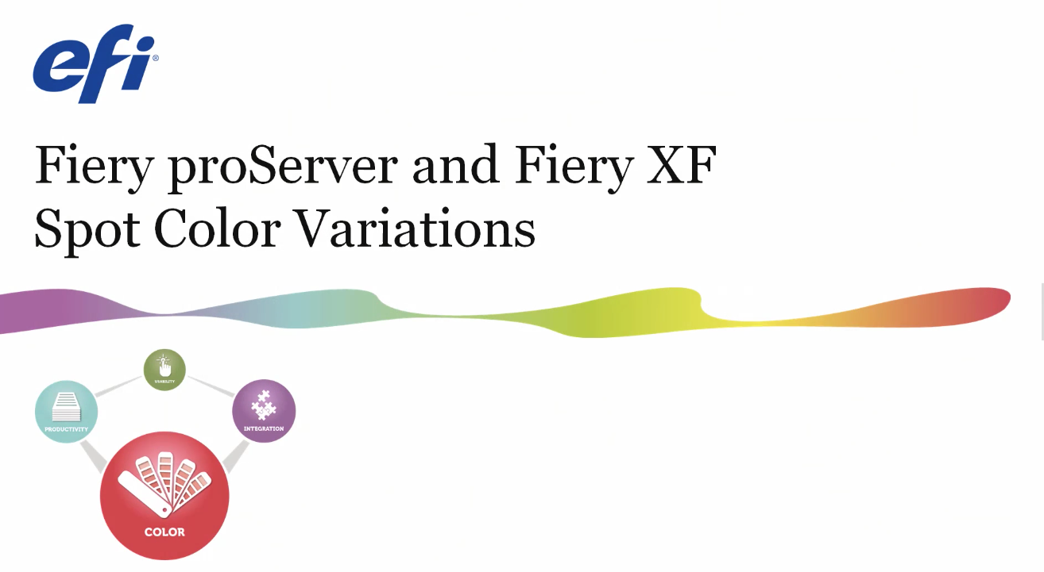
Version 6.4 technical videos
Version 6.4 videos can be found in the EFI Video Library
Fiery proServer and Fiery XF 6.4 technical overview
6.4 licensing and installation
Spot color variations
IP Printing with Fiery proServer and Fiery XF 6.4

Slide 30
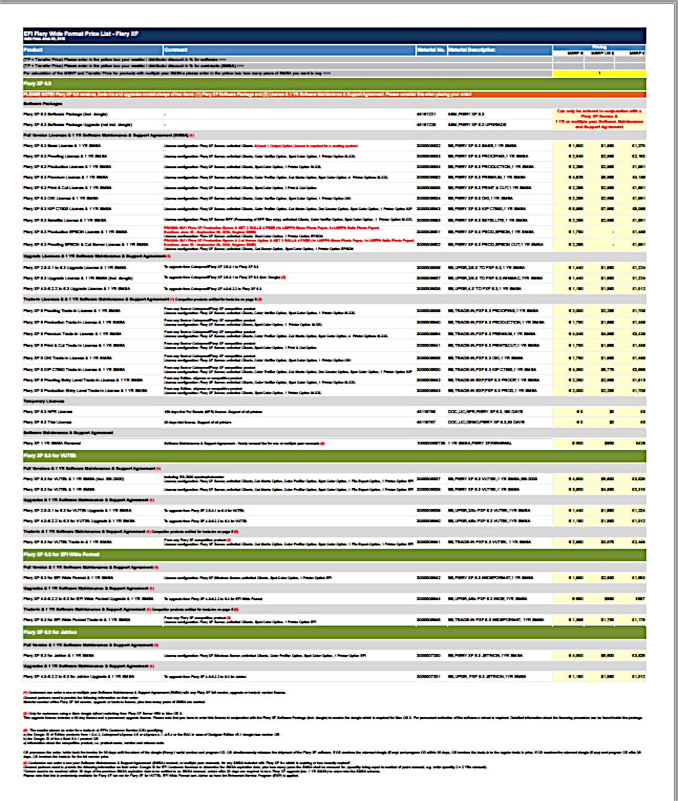
New 6.4 price list
A new price list is available for Fiery proServer and Fiery XF which has the following changes:
The removal of the Fiery Layout Option
Updated descriptions to reflect the 6.4 version number Updated descriptions of NFR and Trial licenses
Removal of the 2.x / 3.x upgrade to version 6.x for EFI Wide Format
Updated Inkjet Solutions Services & Training tab with additional and updated offerings

Slide 31
Availability of 6.4
Version 6.4 requires a 6.4 license to be activated and installed before the online update can be run
6.4 is available as an online update and can be applied to 6.3.x versions that have a 6.4 upgrade license installed
Earlier versions need to be upgraded to 6.3.x first
In-agreement customers, SMSA (Software Maintenance & Support Agreement) and ESP (Enhanced Service Agreement) will have their upgrade license pre-activated for them, all they have to do is download
Non-agreement customers need to purchase an upgrade or Fiery software agreement based on the product they own and/or their current agreement status

Slide 32
Thank you

